Slide 1



Regional Fire and EMS Services Study Public Information and Input Session
March 19, 2026

Slide 2
Introductions
Chief Richard Edwards, Truckee Meadows Fire Protection District
Chief Dave Cochran, Reno Fire Department
Chief Walt White, Sparks Fire Department
Dave Solaro, Washoe County Assistant County Manager
JW Hodge, City of Reno Assistant City Manager
Barry Duplantis, REMSA President/CEO
Reggie Salvador, Emergent Global Solutions
Rick Martinez (Fire Chief, Ret.), Ardenis Solutions

Slide 3
Why We’re Here
Region is growing — increasing demand for fire prevention, fire protection, and Emergency Medical Services (EMS)
Current system has resource and coordination gaps across jurisdictions
Changing weather patterns are raising wildfire risk
Citizens deserve response from the closest available resource regardless of boundary
Fewer 911 transfers, efficient and equitable use of taxpayer dollars
Modern, coordinated services that match our region's growth

Slide 4
How We Got Here
2003–2023: Years of prior studies and regional collaboration
February 6, 2025: All governing bodies meet concurrently — commitment to act
February 2025–present: Working group meets regularly (City Managers, Fire Chiefs, REMSA, Dispatch)
Focus areas: CAD/RMS upgrade, automatic aid agreements, common SOGs, joint training
June 9, 2025: Governor Lombardo signs Senate Bill 319, mandating this study

Slide 5
About the Study
Study board established via interlocal agreement pursuant to SB319; three meetings held to date
Emergent Global Solutions selected as study consultant
Data collection underway across all agencies
Study will examine response times, operational costs, legal requirements, governance models, funding mechanisms
Final report due December 31, 2026
Notes:
Identify Study Board Members – Chair Mariluz Garcia (WC), Vice Chair Joe Rodriguez (S), Members Brandi Anderson (R). Paul Anderson (S), Clara Andriola (WC), Miguel Martinez (R)
Study Board is NOT authorized to mandate consolidation
Study Board in NOT authorized to levy new taxes, fees or assessments

Slide 6
Study Team: Who are We & What do we do?
Emergent Global Solutions
Renowned public safety consulting firm. Leveraging experience in crisis management, fire & emergency services, security and disaster recovery, EGS offers years of leadership and extensive all-hazard operational experience.
Ardenis Solutions LLC
Providing agencies & communities with the tools and knowledge necessary to effectively mitigate risks and respond to emergencies. Ardenis has hands on experience in regionalizing fire departments and emergency services functions and organizations

Slide 7
Study Goal, Tasks & Approach
Goal:
Identify opportunities for regional collaboration, and recommend options to improve service delivery, operational efficiency, and fiscal responsibility.
Tasks:
Provide recommendations for service enhancement and equity in service delivery
Review operations standards
Emergency medical service integration
Insurance impact, and legislative impact

Slide 8
What Are We Not Doing?
We are not making decisions, we are only providing assessments, options and recommendations
Who Will Decide if Any Changes Will be Made?
The governing bodies of the agencies (City of Reno, City of Sparks and the Truckee Meadows Fire Protection District Board of Fire Commissioners)

Slide 9
EGS/Ardenis Approach:
Draw on the significant work that has already been completed
Focus on efficiency, cost effectiveness and practicality
Solicit the ideas and opinions of experienced specialists, your public safety professionals and the public to guide our assessment and assist in forming our recommendations

Slide 10
Tasks Summary:
We have just started the data gathering processes and interviewing of your leadership and key stakeholders
Key Study Tasks:
Service Enhancement: will include ways to increase efficiency and improve services
Operational Performance: analyze current baseline performance metrics and compare with contemporary standards, which will include equity in service delivery

Slide 11
Tasks Summary (cont’d):
Operational Structure: dispatch, deployment, regional collaboration, staffing practices, equipment and training
Emergency Medical Services Integration: actions to improve integration of fire-based EMS responses and ambulance transport.
Insurance: evaluate how any changes to services may affect the insurance environment
Legislation: based on the Study’s findings, consider the implications for changes to laws, regulations and local ordinances
Financial Modeling: any recommendation will include a cost analysis

Slide 12
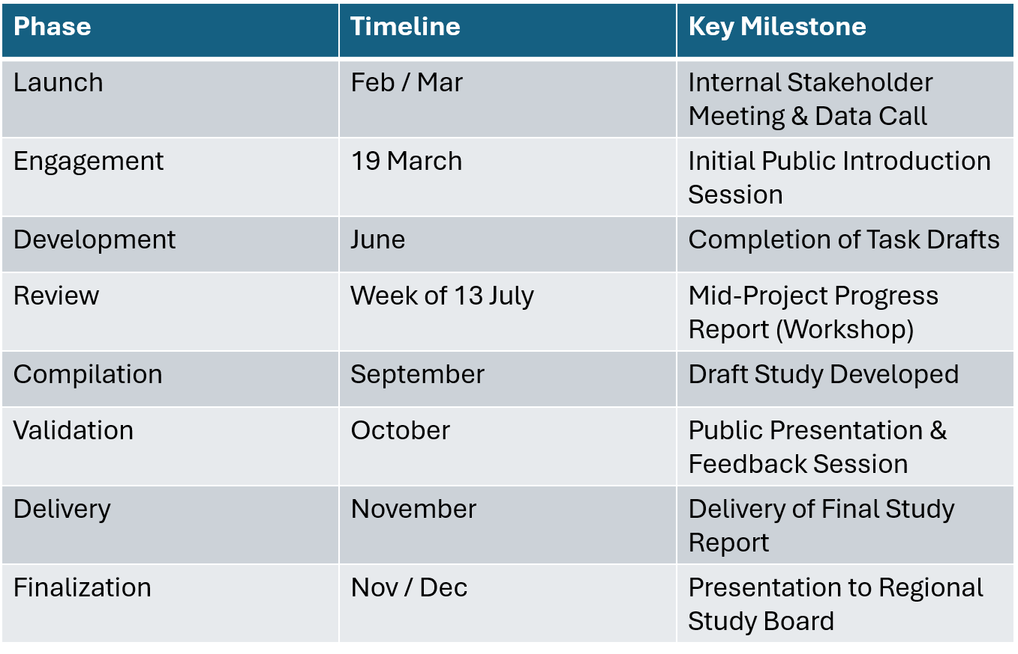
Regional Fire and EMS Study Timeline

Slide 13
Key Deliverables
The Final Study Report will include:
Feasibility and Service Enhancement Assessment
Standards of Cover Framework and Deployment Strategy
Financial modeling scenarios including a Funding Strategy and Implementation Plan
Report on Governance, Policy, and Dispatch
Insurance Evaluation for any recommendation
Recommendations for legislative/regulatory changes
Transition Plan for Regionalization

Slide 14
What Comes Next
Draft report released for public input Late Summer/Early Fall 2026
Final report presented to Study Board November 2026
Final report submitted to Washoe County Board of County Commissioners, Reno City Council, and Sparks City Council no later than December 31, 2026
Governing bodies review findings and make decisions

Slide 15
How to Get Involved
Today: speak during public input period, sign up for updates
After today: complete the survey, attend future Study Board meetings, comment on the draft report

Slide 16
Public Input Period

Slide 17
Key Takeaways
Our region is growing — emergency services must keep pace
SB319 mandates a comprehensive regional study
Agencies are already collaborating: Computer Aided Dispatch upgrades, mutual and automatic aid agreements, joint training
Report due December 31, 2026
Your input shapes the findings and recommendations

Slide 18
Resources and Contact Information
Public Input Survey: https://engage.zencity.io/washoe-county-nv/en-US/engagements/87090fc5-8b83-4335-bb69-5eeb6f3471cb?utm_medium=referral
Regional Fire Services Study Public Engagement Website
https://washoe-county-nv.civilspace.io/en/projects/regional-fire-services-study
Regional Fire Services Study Board Website
https://www.washoecounty.gov/mgrsoff/board_committees/regional-fire-services-study-board/index.php
Cadence Matijevich email: cmatijevich@washoecounty.gov

Slide 19
Final Slide – Shows logos for City of Reno, Washoe County and City of Sparks

